Slide 1
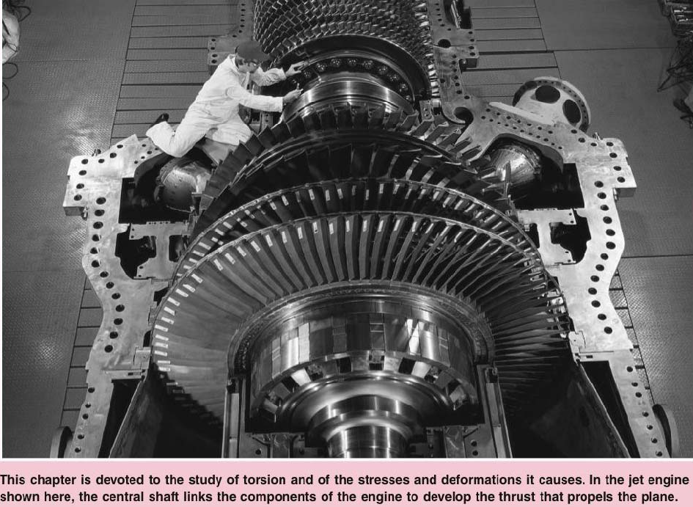
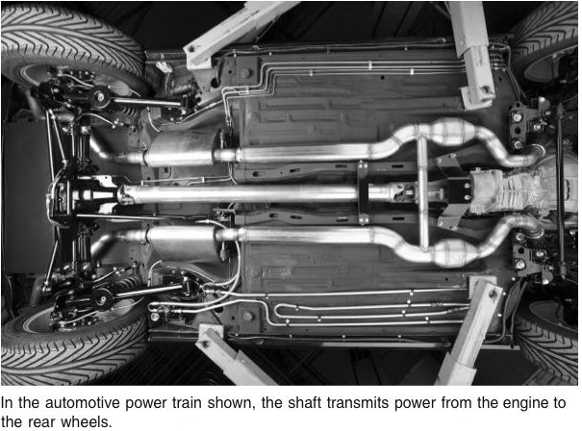
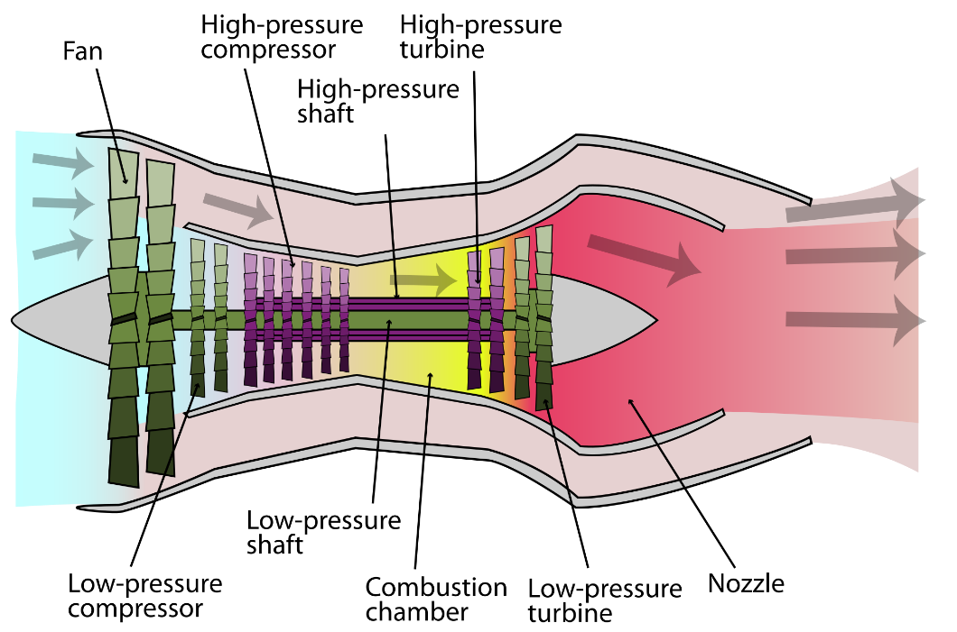
TORSION
Chapter 6

Slide 2
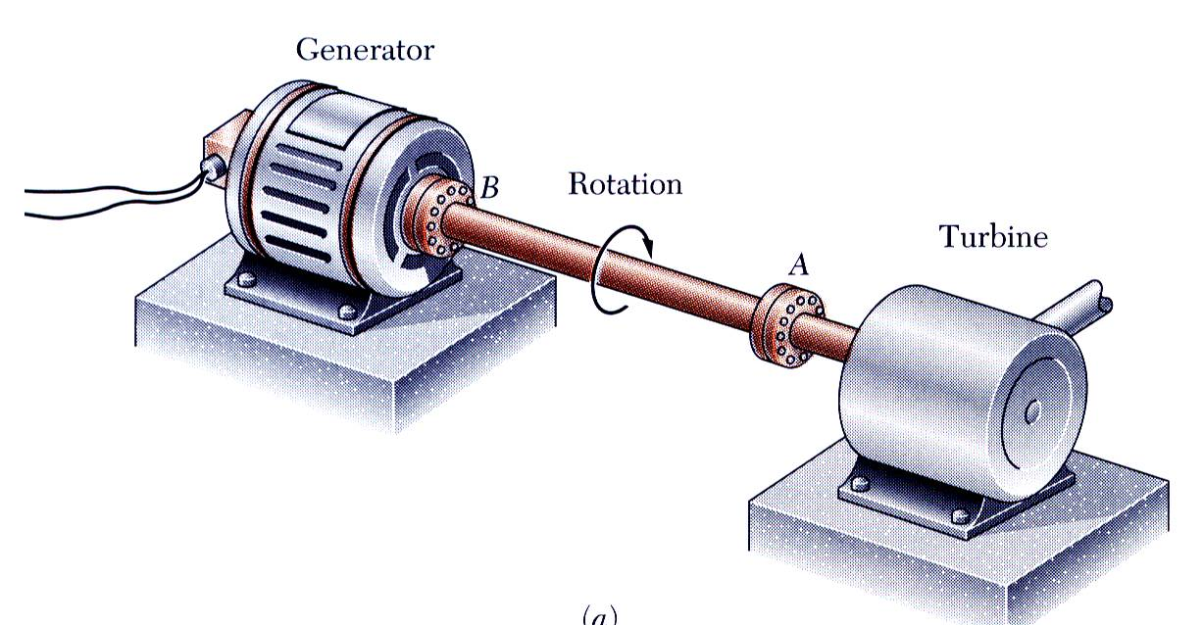
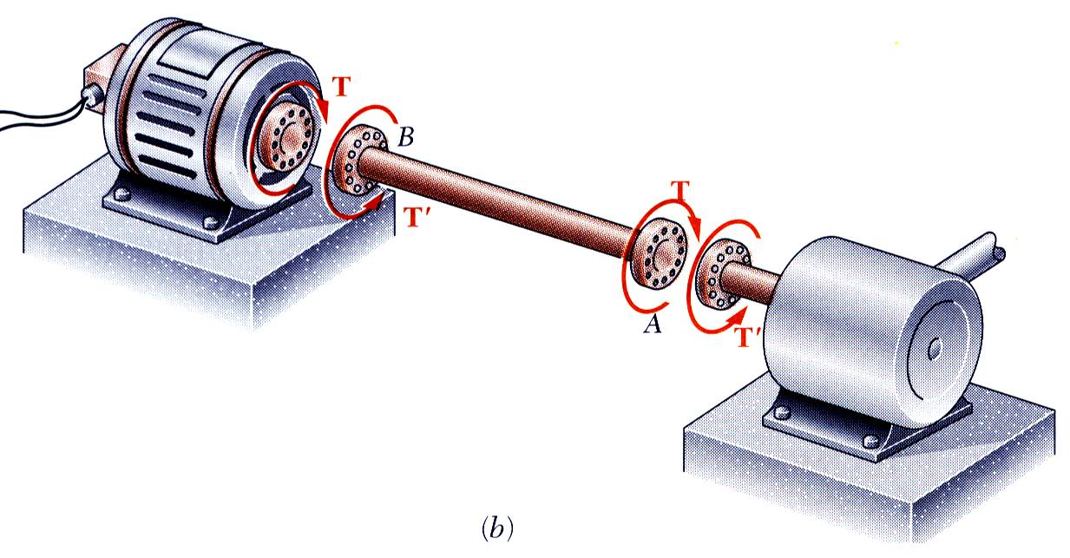
Torsional Loads on Circular Shafts
Interested in stresses and strains of circular shafts subjected to twisting couples or torques
Turbine exerts torque T on the shaft
Shaft transmits the torque to the generator
Generator creates an equal and opposite torque T’
In the transmission of power by a shaft in torsion, we are interested primarily in the twisting moment which can be transmitted by the shaft without damage to the material, and hence we wish to know what the stresses are in the shaft.

Slide 3
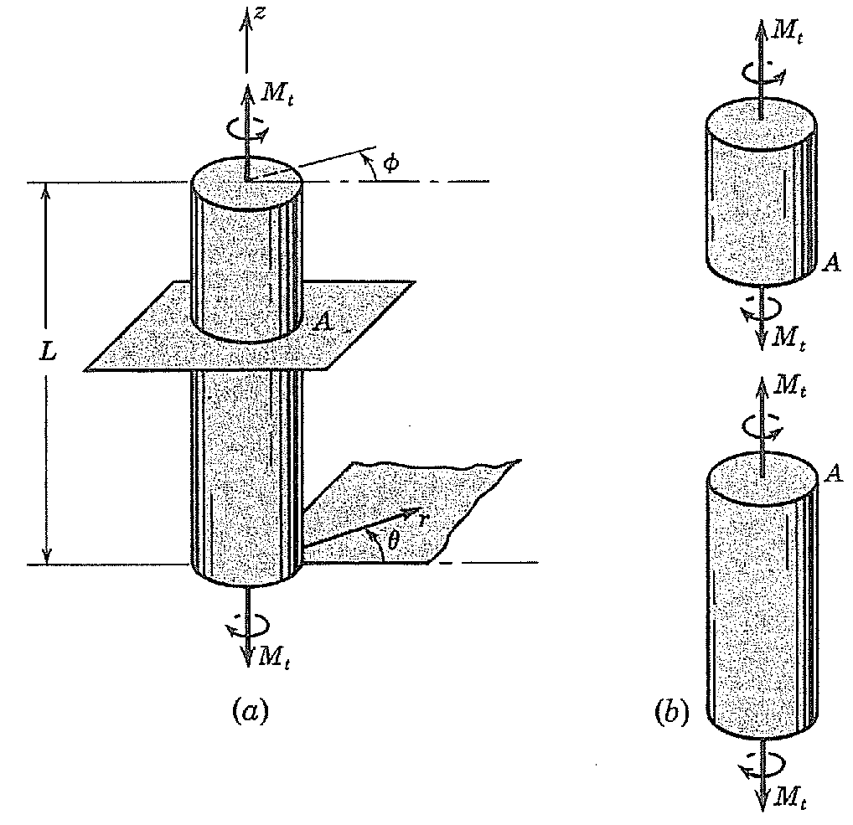
Geometry of deformation of a twisted circular shaft
Use of cylindrical coordinates r, Ɵ, z
Equilibrium requires that each cross section of the shaft must transmit the twisting moment M_{t} .

Slide 4
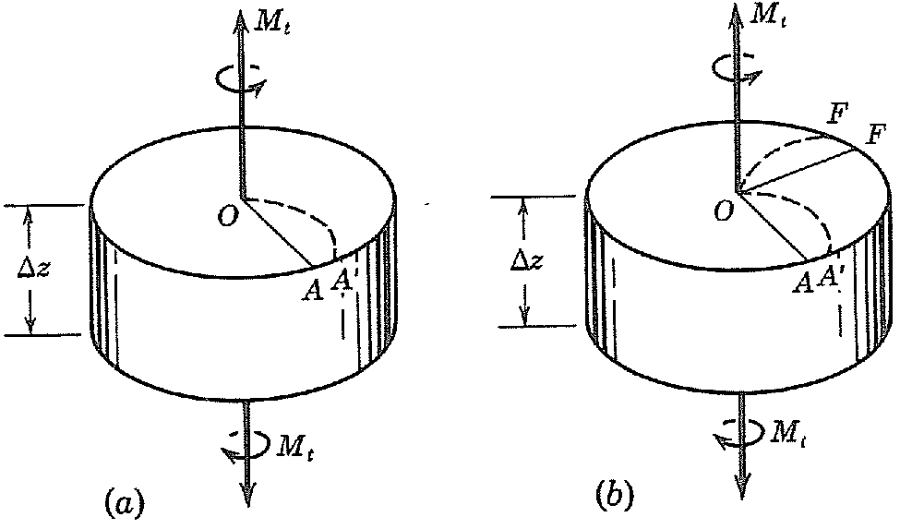
When a circular shaft is twisted, the cross sections must remain plane

Slide 5
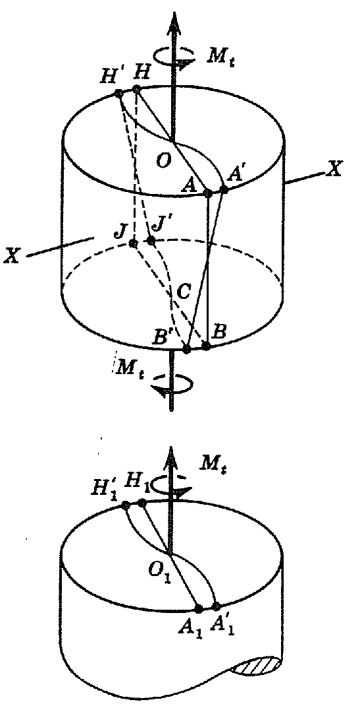


Slide 6
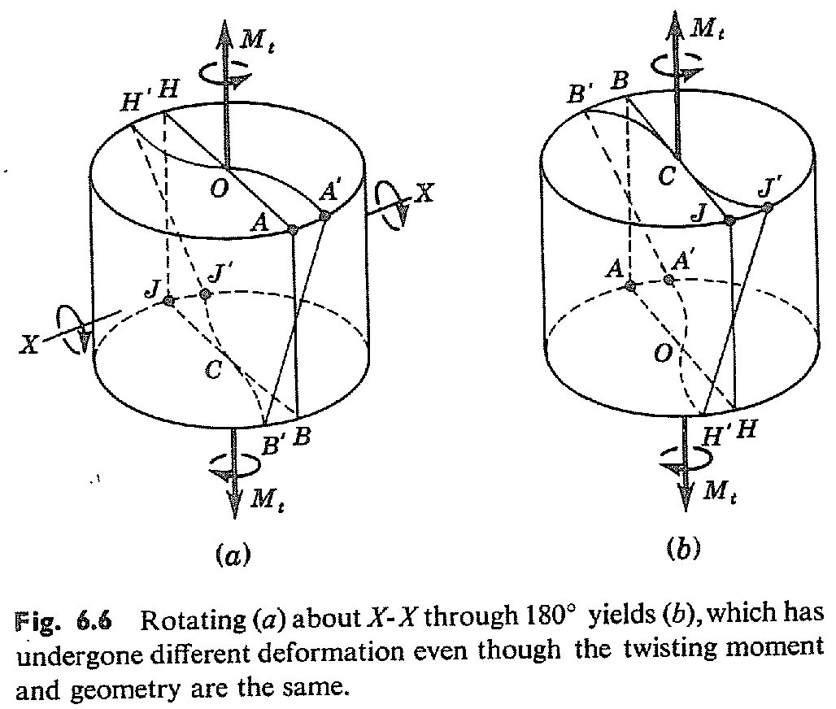

Slide 7
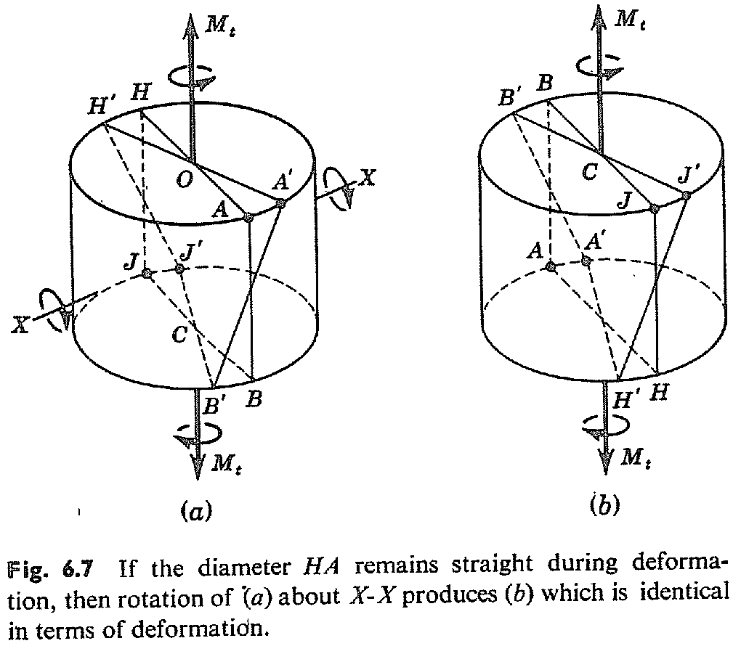
Each plane cross section originally normal to the axis remains plane and normal and does not distort within its own plane.

Slide 8

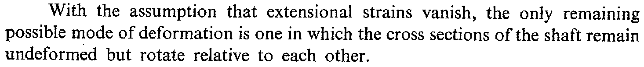
Dilational deformation

Slide 9
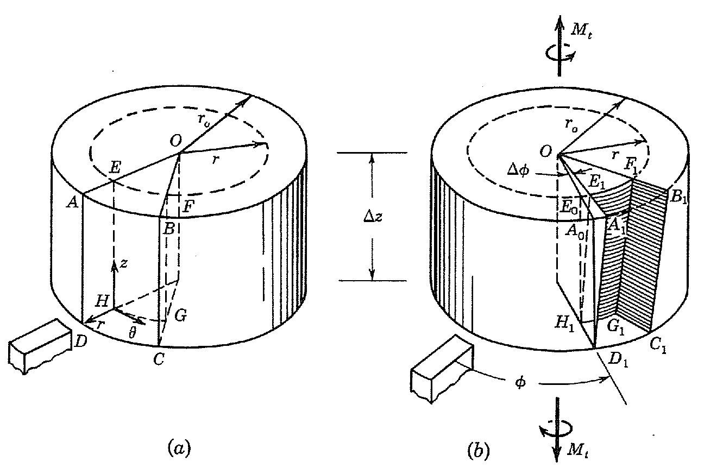
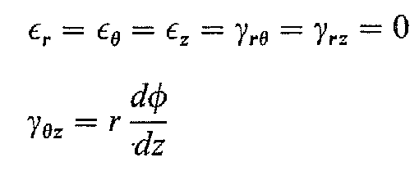

Slide 10
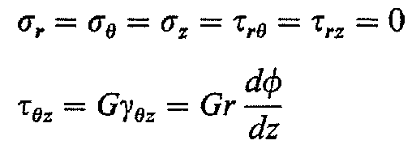
Stresses obtained from stress strain relations

Slide 11
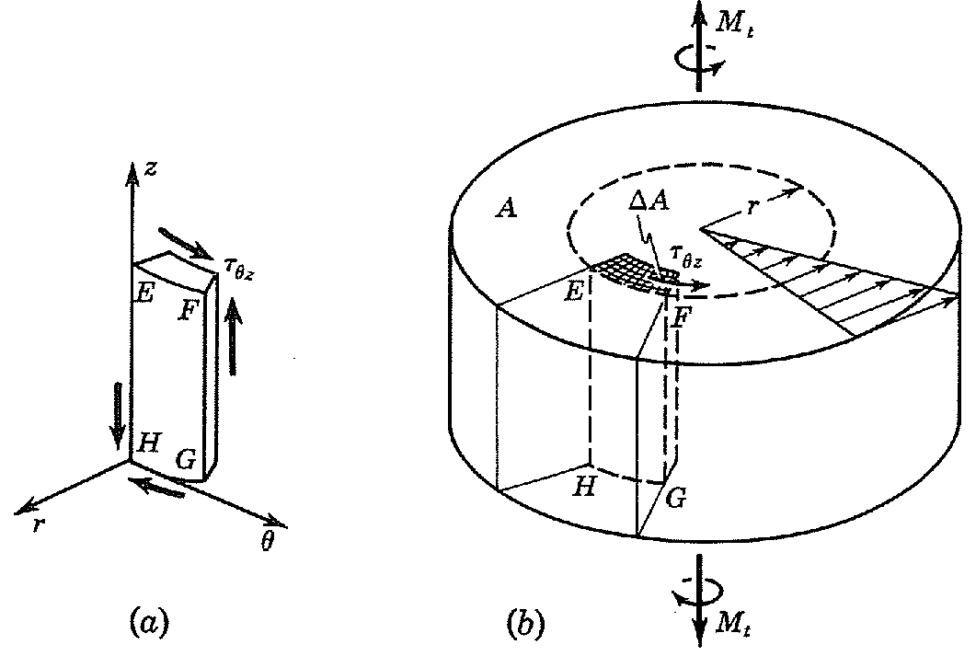
Equilibrium requirements

Slide 12
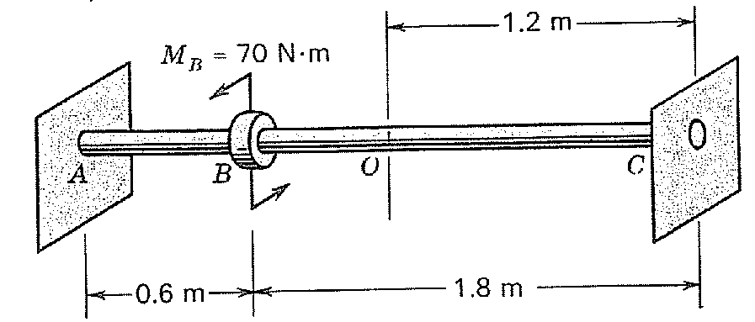
Dia = 25 mm; aluminum alloy shaft.
Find the angle through which O rotates.
G = 26.5 GN/m²

Slide 13
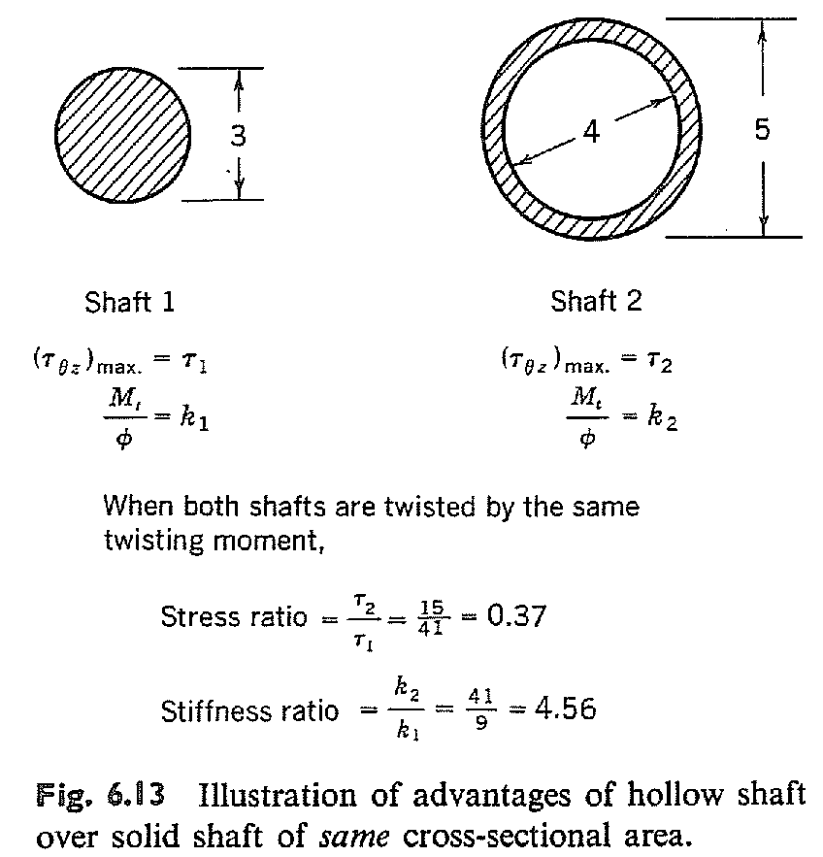
Torsion of elastic hollow circular shafts
Making a concentric hole in a shaft does not reduce the torsional stiffness in proportion to the amount of the material removed

Slide 14
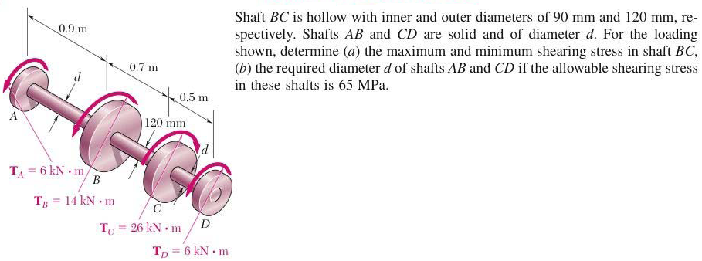
Problem

Slide 15
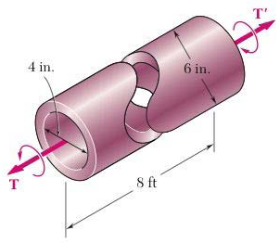
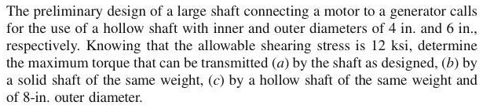
Problem

Slide 16
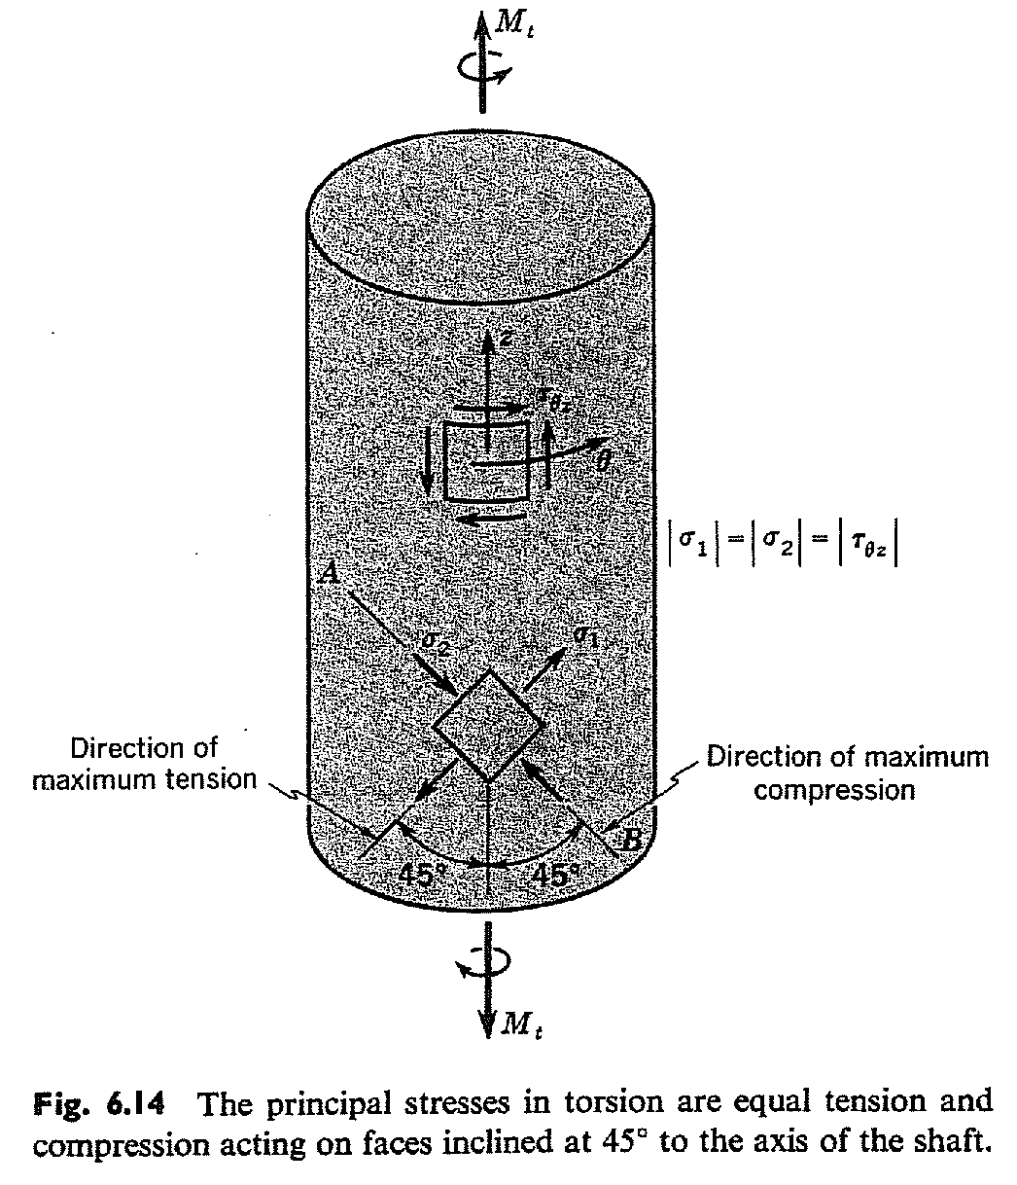
Stress analysis in torsion: Combined Stresses

Slide 17
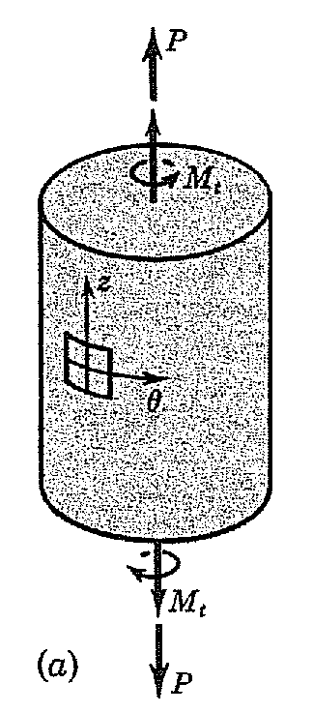
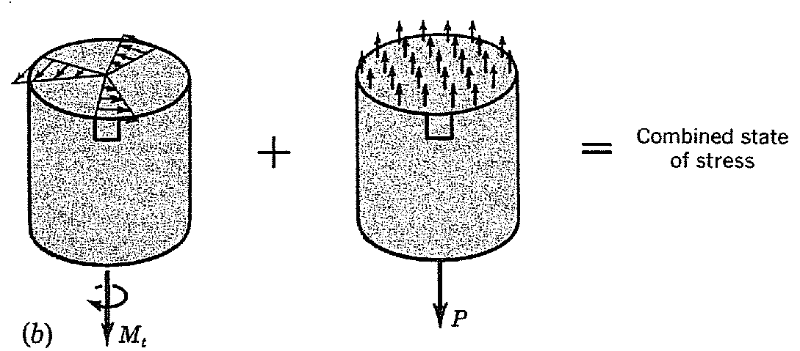
Stress analysis in torsion: Combined Stresses
A uniform, homogeneous circular shaft is subjected to an axial tensile force P and a twisting moment M_{t}.

Slide 18
Strain energy due to torsion
The onset of yielding in torsion
Mises yield criterion
Maximum shear-stress criterion

Slide 19
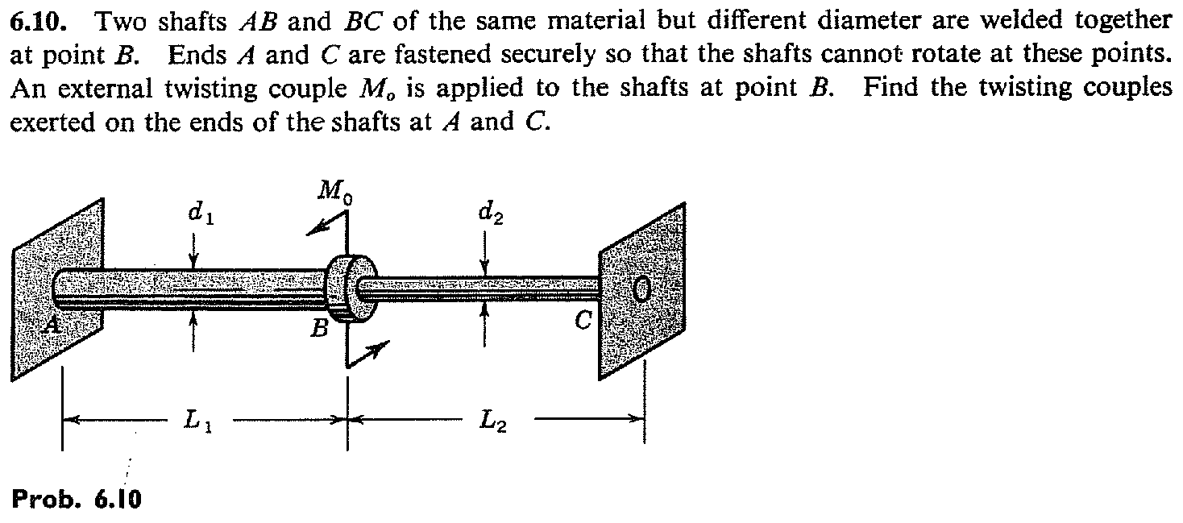

Slide 20
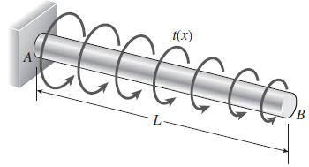
A prismatic bar AB of solid circular cross section, (diameter d) is loaded by a distributed torque (see figure). The intensity of the torque, that is, the torque per unit distance, is denoted t(x) and varies linearly from a maximum value t_{A} at end A to zero at end B. Also, the length of the bar is L and the shear modulus of elasticity of the material is G.
(a) Determine the maximum shear stress max in the bar.
(b) Determine the angle of twist Φ between the ends of the bar.

Slide 21
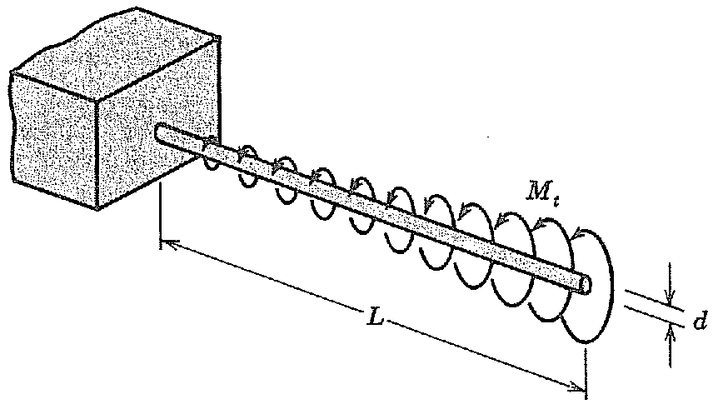

Slide 22
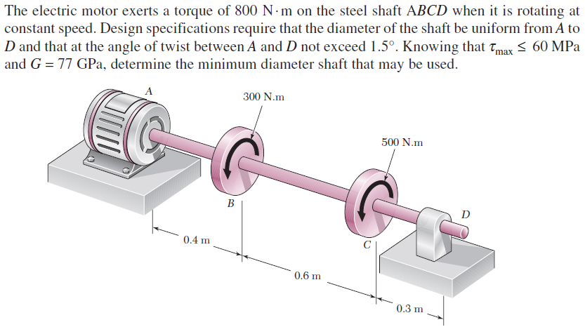

Slide 23
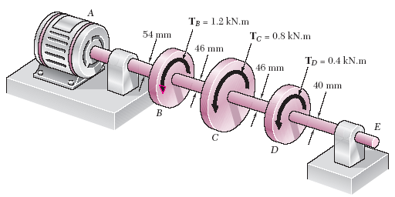
Under normal operating conditions, the electric motor exerts a torque of 2.4 kN-m at A. Knowing that each shaft is solid, determine
(a) The shaft in which maximum shearing stress occurs.
(b) The magnitude of that maximum shearing stress.
(c) The angle of twist between A and E.
[ G = 77 GPa, ν = 0.32, L_{AB} = L_{BC} = L_{CD} = L_{DE} = 0.5 m]

Slide 24
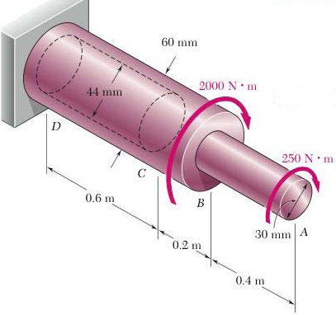


Slide 25
100 mm
60 mm
80 mm
L₁
L₂
L₃
A steel shaft has a total length of 3m and has different sections as shown in Fig. The first section is hollow having internal and external diameters 60 mm and 100 mm respectively. The second section is a solid shaft of diameter 100mm and the third section is a solid shaft of diameter 80 mm. If all these sections are joined rigidly to each other and the angle of twist at each section is same. Find the
a) Length of each section.
b) Maximum torque and angle of twist.
Maximum shear stress in hollow section is 47.5 MPa.
Assume G = 82.5 GPa.

Slide 26
2000 N.m
250 N.m
0.06 m
0.03 m
0.6 m
0.4 m
0.2 m
D
C
B
A
The horizontal shaft AD is attached to a fixed base at D and is subjected to the torque 250 N-m at A and 2500 N-m at C which is 0.6 m from D. Knowing that the entire shaft is made of steel for which G = 77 GPa. Determine the angle of twist at end A.

Slide 27
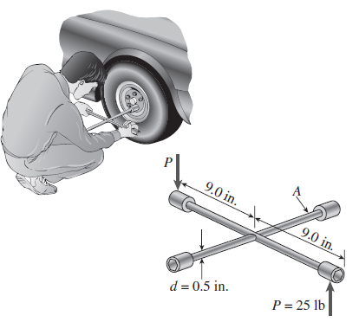
While removing a wheel to change a tire, a driver applies forces P=25 lb at the ends of two of the arms of a lug wrench (see figure). The wrench is made of steel with shear modulus of elasticity G=11.4x10⁶ psi. Each arm of the wrench is 9.0 in. long and has a solid circular cross section of diameter d=0.5 in.
(a) Determine the maximum shear stress in the arm that is turning the lug nut (arm A).
(b) Determine the angle of twist (in degrees) of this same arm.

